Slide 1
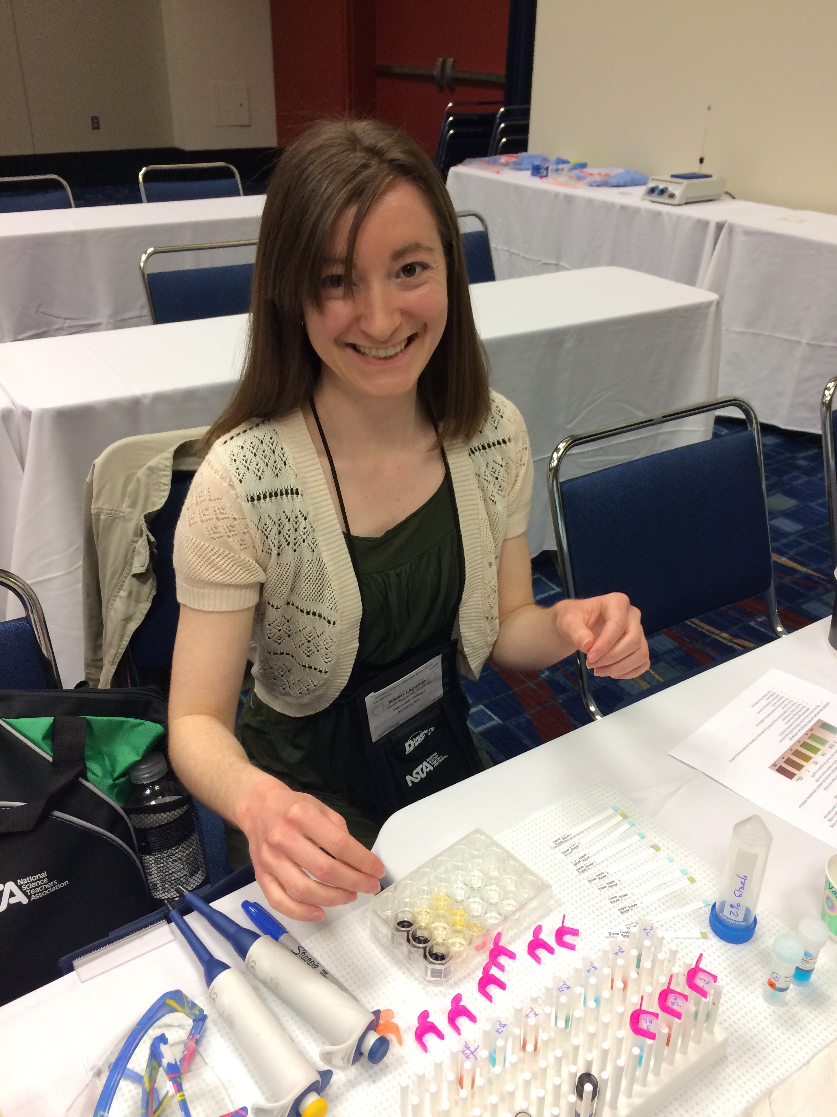
Proteins are the Cash of Biotech
Lab 6d Assaying for Amylase Activity
(B:S4NM The rAmylase Project Kits) Kit # BTNM-6C
Ellyn Daugherty
ellyn@BiotechEd.com
www.BiotechEd.com
Colin Heath
G-Biosciences
cheath@gbiosciences.com

Slide 2
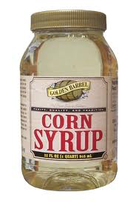
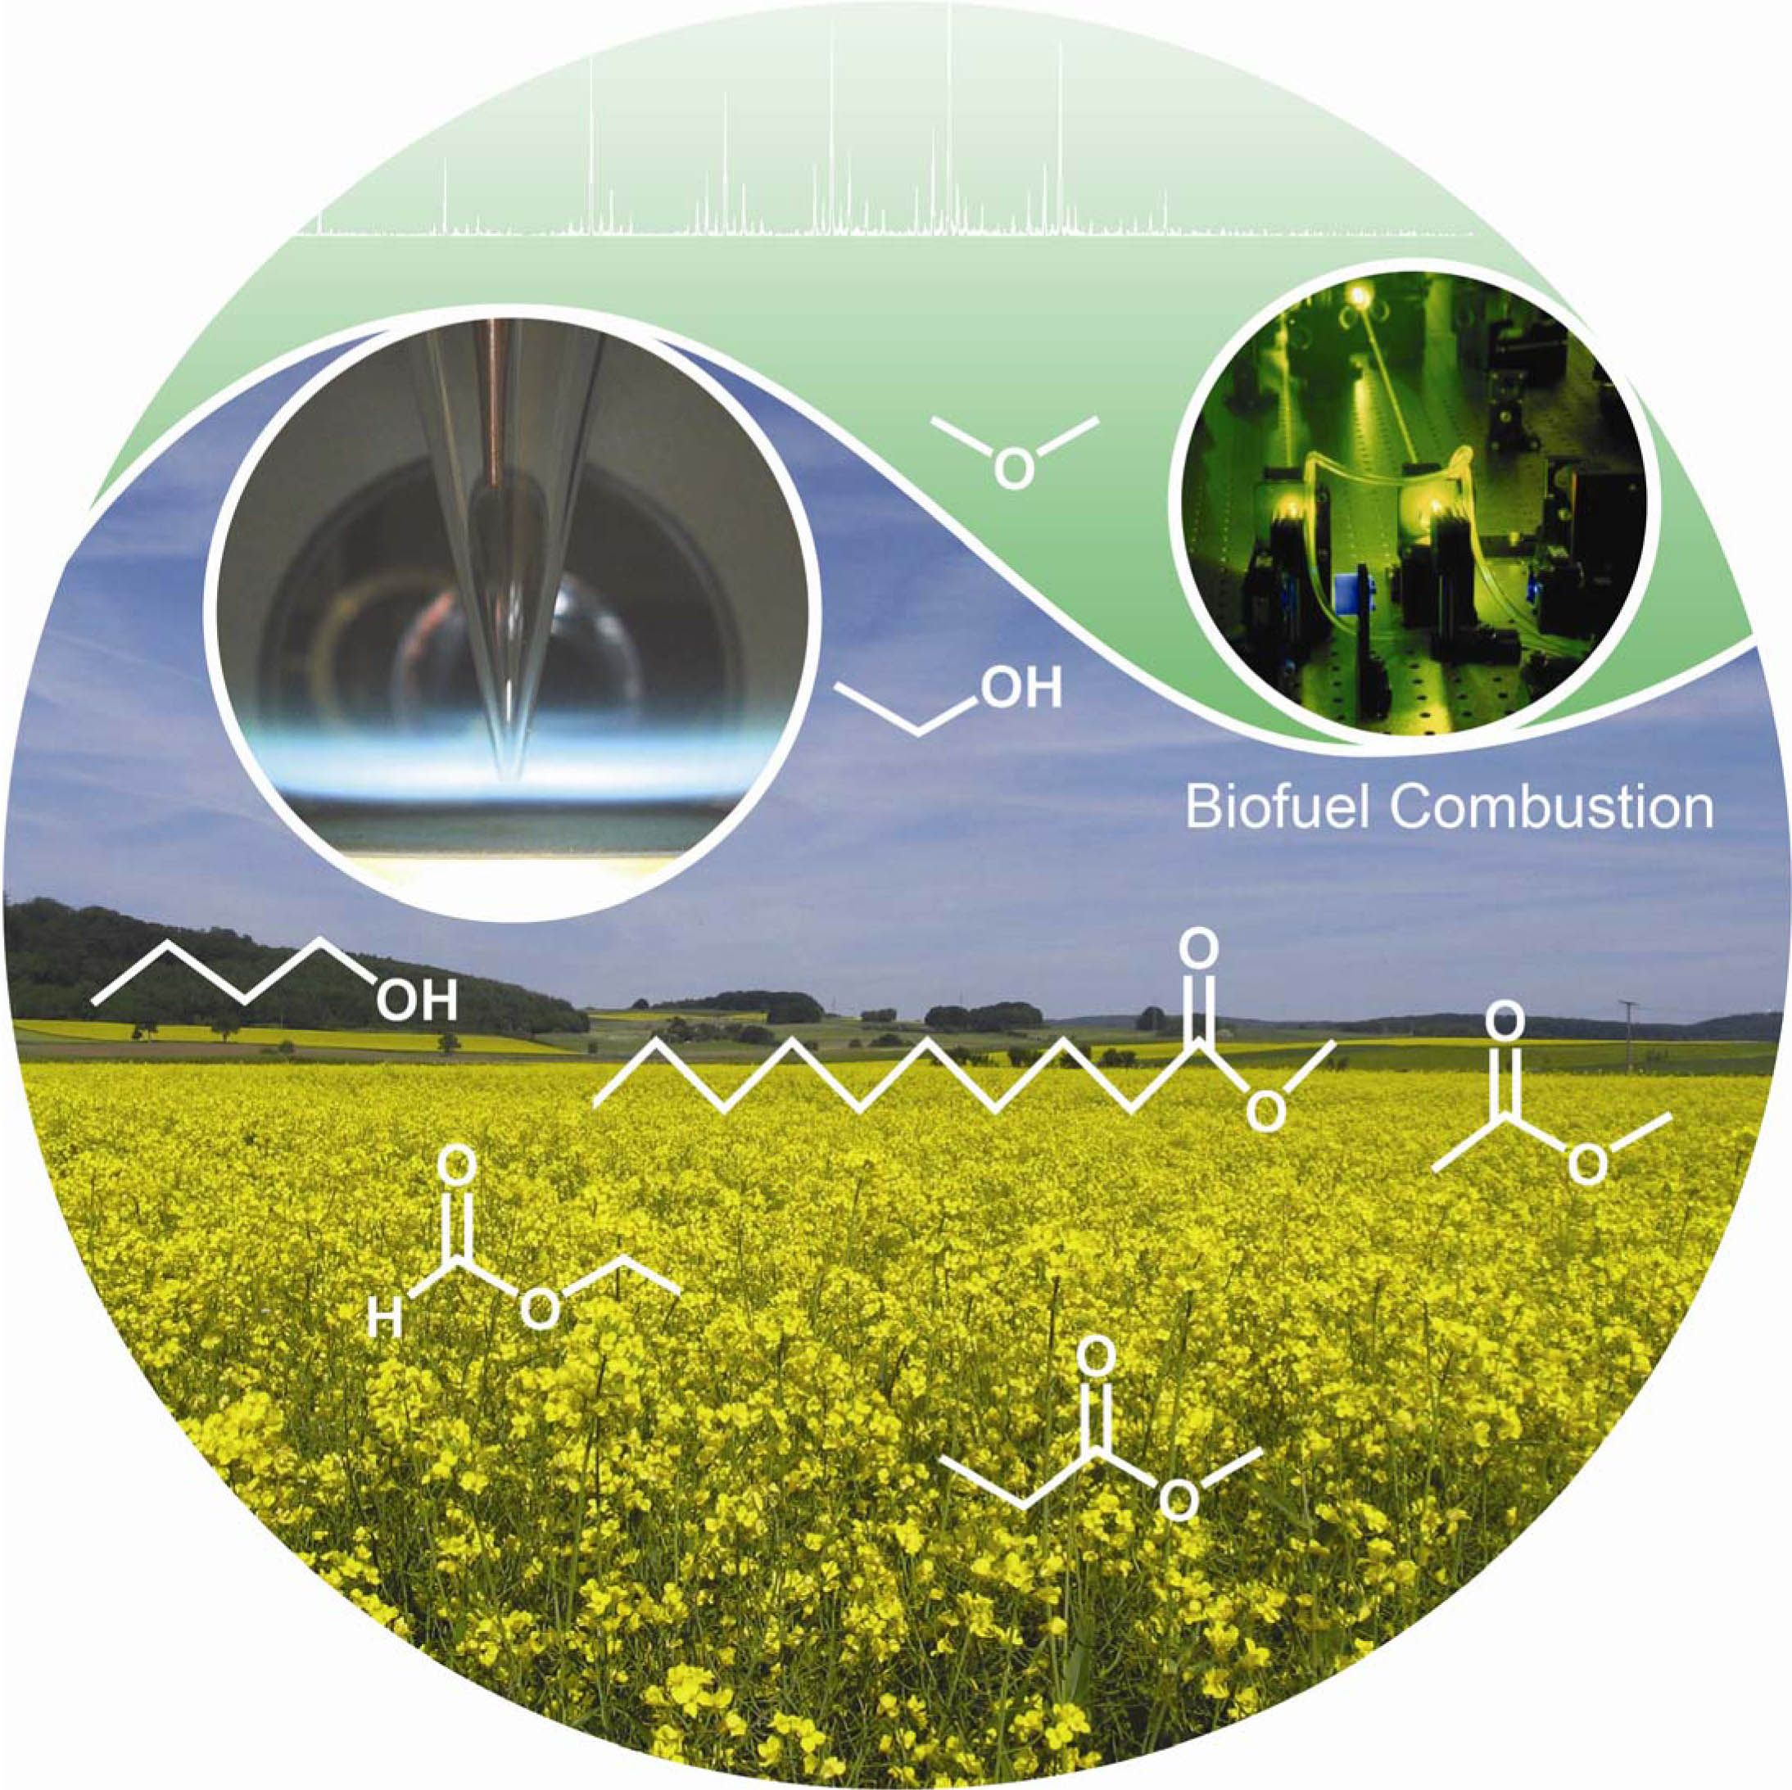
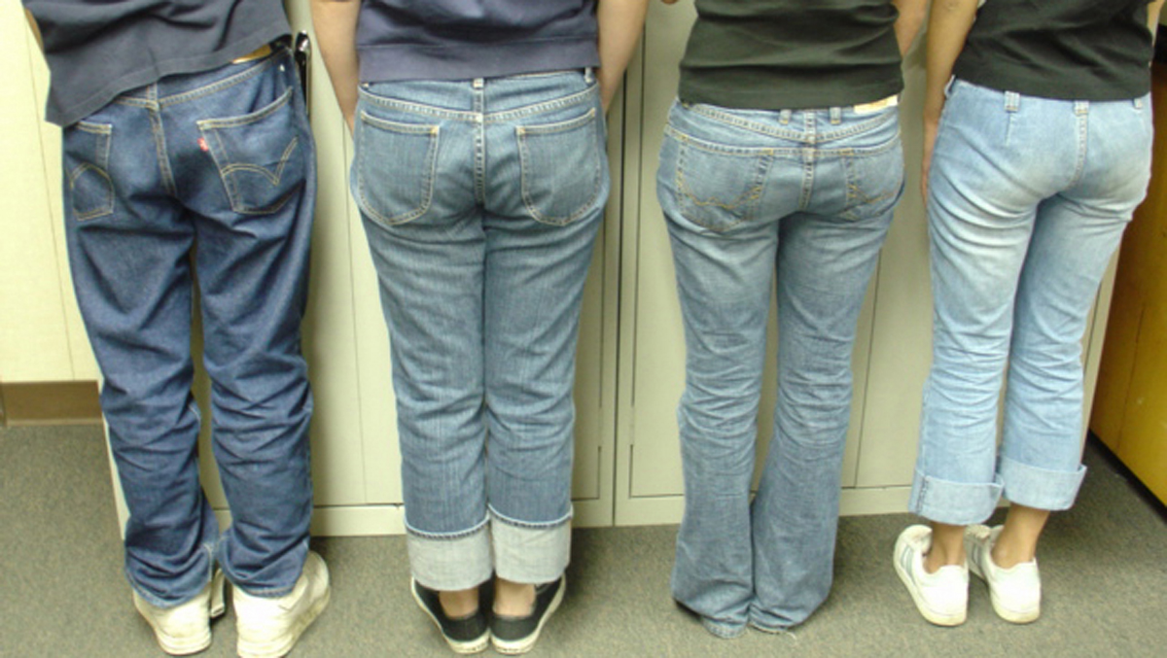
Amylase is a
commercially important biotech product
Amylase is an enzyme that catalyzes starch digestion to sugar. Used to:
Remove starch in products
Produce sugar from starch
Processing of cellulostic biofuel

Slide 3
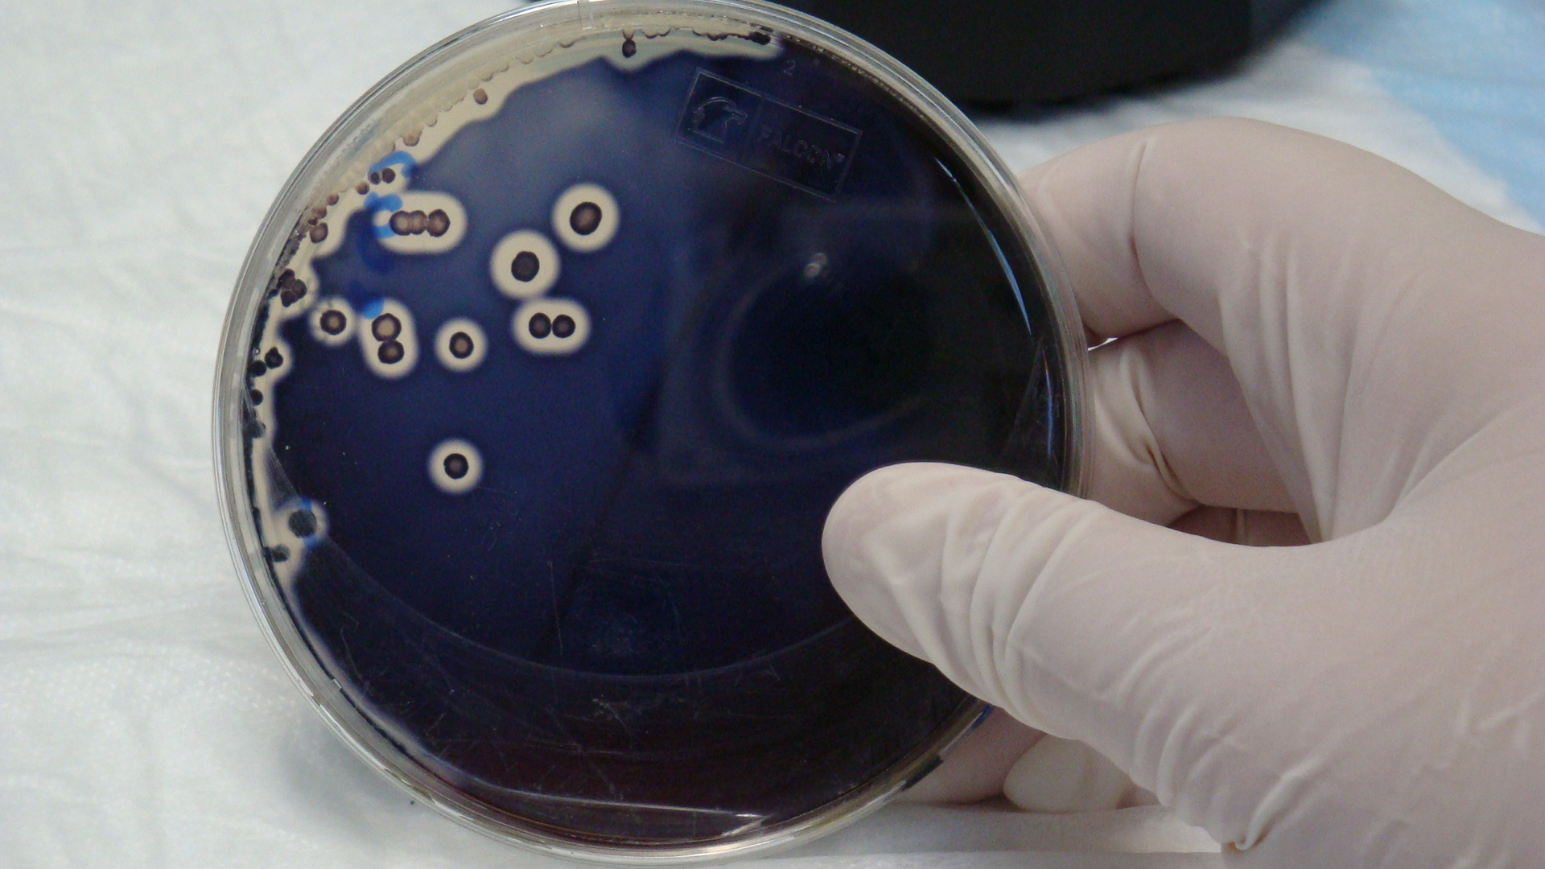
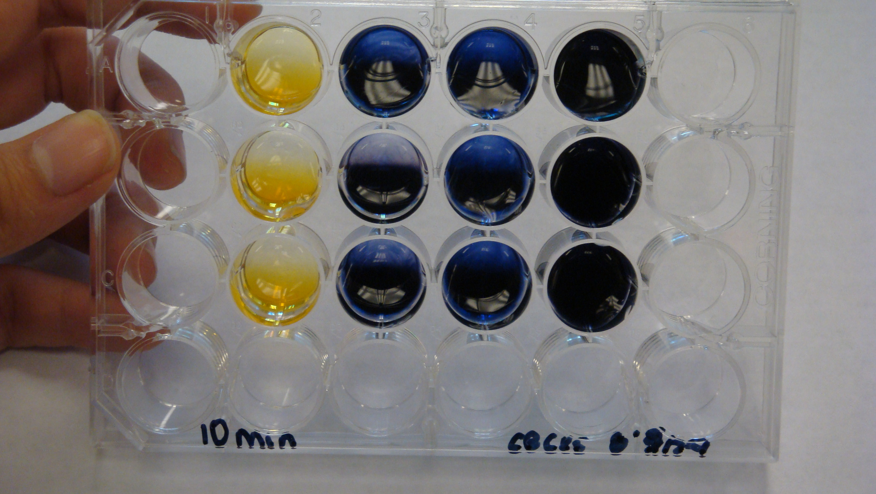
The goal of The rAmylase Project is to
Learn how to assay for amylase, a protein of commercial interest (rAmylase)
Genetically engineer cells to produce amylase (using pAmylase2014)
Grow transformed cells to volumes where amylase is purified and assayed

Slide 4
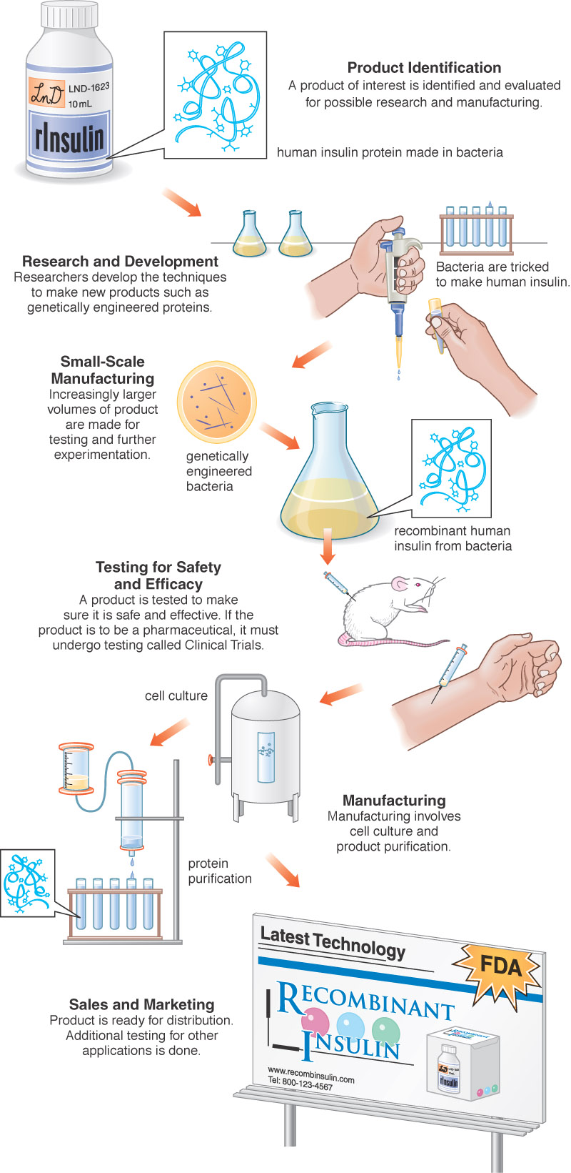
The rAmylase Project Curricular model of rDNA/protein Business
Chapters 1-5 Basic SLOP
Lab 5f Characterizing Proteins by PAGE
Lab 6d Assaying for Amylase Activity (6c)
Lab 6e Direct ELISA of Bacterial Amylase (6d)
Lab 6f Western Blot to Identify Amylase (6e)
Lab 7d Amylase Concentration Assay (7g)
Lab 8b pAmy Plasmid Restriction Digestion
Lab 8c pAmylaseTransformation of E. coli
Lab 8g Miniprep for pAmylase Isolation
Lab 9c Amylase Ion-Ex Chromatography
Lab 13h Amylase Gene PCR
BS4NM Fig 1.21

Slide 9
Computer Modeling of Bacterial Amylase
2 good options:
1a) Using Cn3D, downloadable from NCBI (Tools) … can study the different forms of bacterial amylase
1b) Go to >>> https://www.ncbi.nlm.nih.gov Pick “Structure” in Databases and type “alpha amylase Bacillus licheniformis” in search box
1c) Find entry = PDB ID: 1BLI (download structure) Then in the entry look for “Similar Structures” … and find the engineered alpha amylase = PDB ID: 1E3Z
1d) Download VAST to compare the structures
2a) Use Molecular World application for iPad or iPhone.
Use PDB ID: 1BLI and 1E3Z

Slide 10
Native alpha amylase superimposed with heat-resistant engineered alpha-amylase
See yellow loop - due to additions in the 1E3Z polypeptide
Intended Mutation Produced using PCR

Slide 11
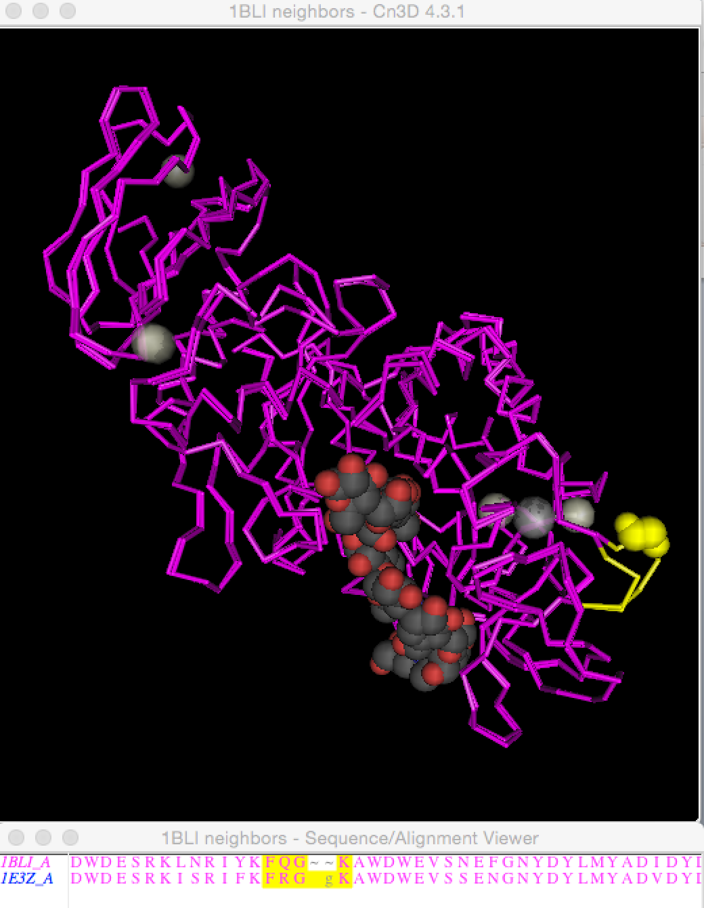
In this Cn3D view, you can see that the starch substrate still binds at the active site.
See yellow loop - due to additions in the 1E3Z polypeptide

Slide 12
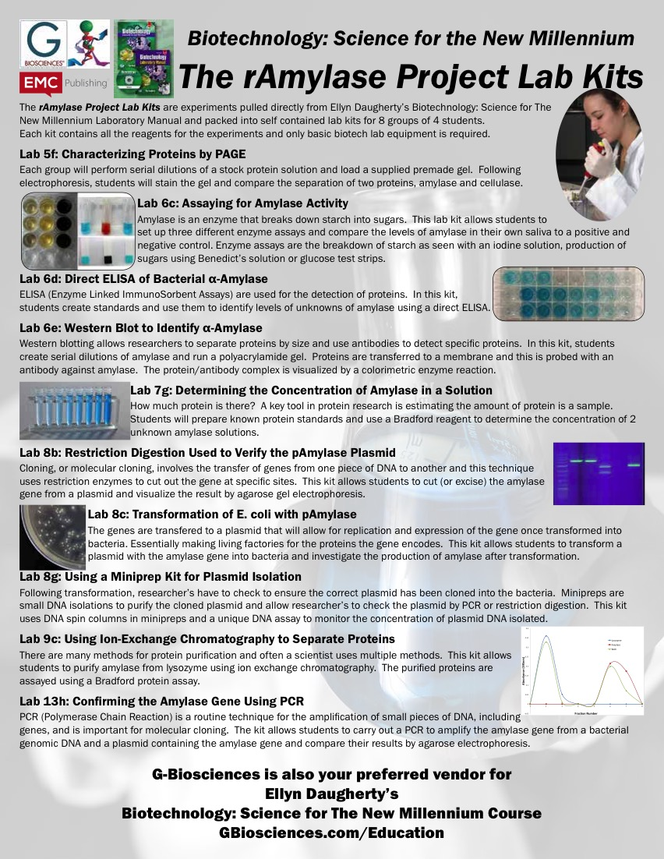

Slide 13
BiotechEd.com Biotech Teacher Support Site
BiotechEd.com PPTS, Syllabi, Activities, Hints, Links, etc.
www.gbiosciences.com/BTNM
B:S4NM materials and kits
and
FisherEdu.com/BS4NM
for entire BS4NM materials lists
emcp.com/biotech B:S4NM curriculum

